Slide 1

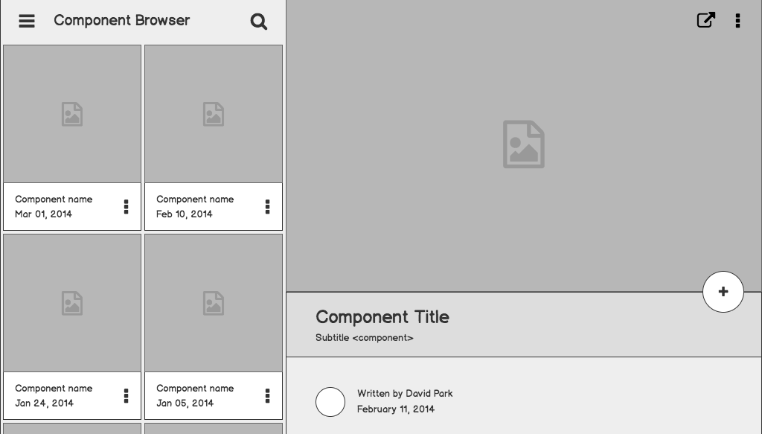

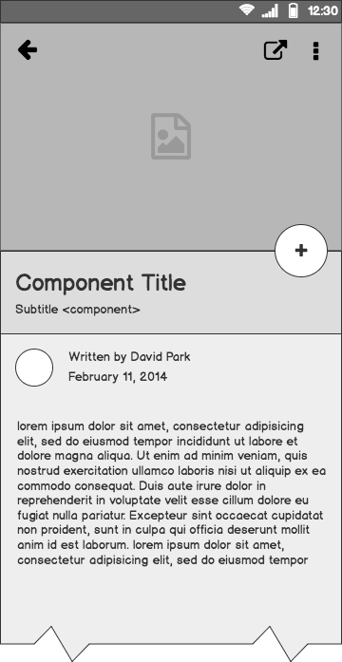
WebD
Project
Kirti Gupta(16IT8012), Santoshi(16IT8024), Venkatesh(16IT8067)
Date: 16/01/2019
Week: 1

Slide 2
Problem statement
Student Information System:
We create a website which contains the database of students managed by the administrator.
Date: 16/01/2019
Week: 1

Slide 3
Outline
Project Details
Tools Used
Overview of the website

Slide 4
Project Details

Slide 5
There will be two types of accounts: One for the administrator and other for the users. Two separate login systems need to be created.
Administrator is having the right to access the student’s database, add new student’s data, delete any student’s data or update the same.
User or students need to register first by filling up a standard registration form with the fields like Name, Roll No, Branch, Contact No, Address.
The registration request should go to the administrator. Upon acceptance the registration request, the administrator activates the account.
Date: 16/01/2019
Week: 1

Slide 6
Tools Used

Slide 7
Front-end
Tools
HTML
CSS
Javascript
Date: 16/01/2019
Week: 1

Slide 8
Back-end
Tools
PHP
MySQL
Date: 16/01/2019
Week: 1

Slide 9
Overview of the website

Slide 10
Home page: Consists of sign up form for new students and login for administrator and existing students.
Index_students page: After login, the students will be redirected to this page.
In this page the navigation bar consists of 3 options like Home, Profile and About.
Home: This will be redirecting to the same home page of the student.
Profile: This consists of the information about the student.
About: This contains the information about the institute..
Index_admin page: After login administrator will be redirected to this page. It also contains the admin features of modifying student data.
Date: 16/01/2019
Week: 1

Slide 11
Information architecture
Home
Login as student
Login as admin
Sign up
Student sign-in
Student sign-up
Admin
sign-in
Sign in
Sign in
Log out
Log out
Index_student
Home
Index_admin
Date: 16/01/2019
Week: 1

Slide 12
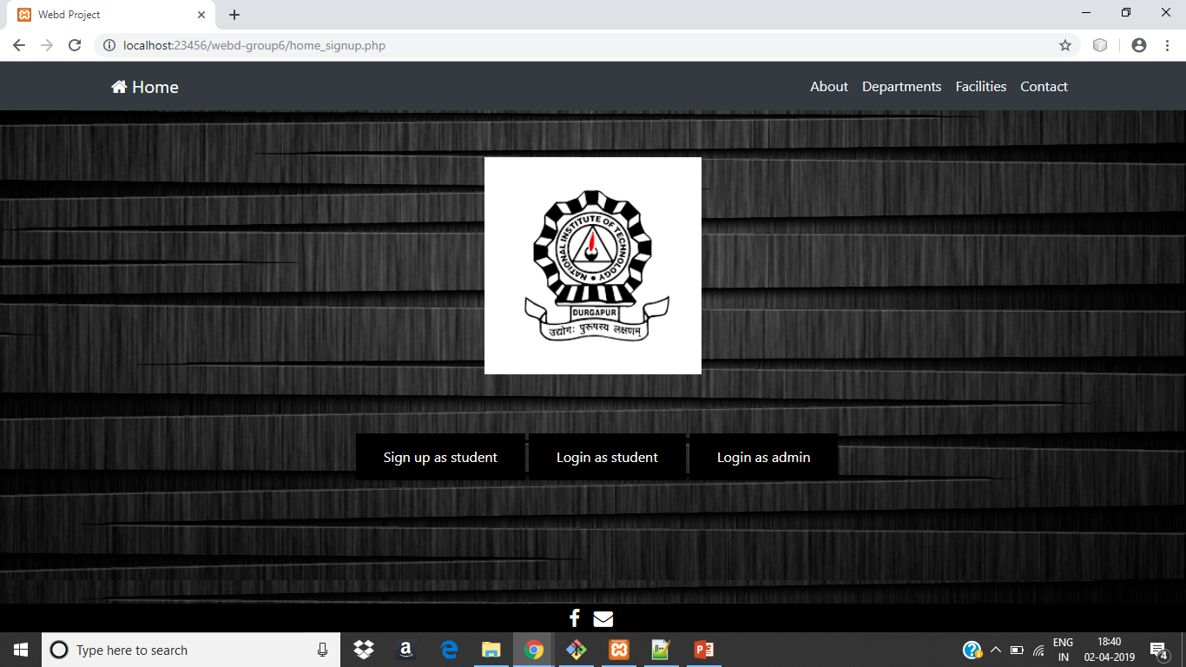
Information architecture

Slide 13
Work
Division
16IT8012: Made the sign up form.
16IT8024: Made the navbar and footer.
16IT8067: Made the changes and addition of pages in the presentation.
Date: 30/01/2019
Week: 2

Slide 14
What We Did ?
Made home page for the user(both student and admin) to login and sign up.
This page consists of a navbar with menu options - Home, Student Login, Admin Login.
The body contains the sign up form for the new student to sign up.
Footer of the page contains the link to the institute’s facebook page and email options to contact the Director of the institute.
Date: 30/01/2019
Week: 2

Slide 15
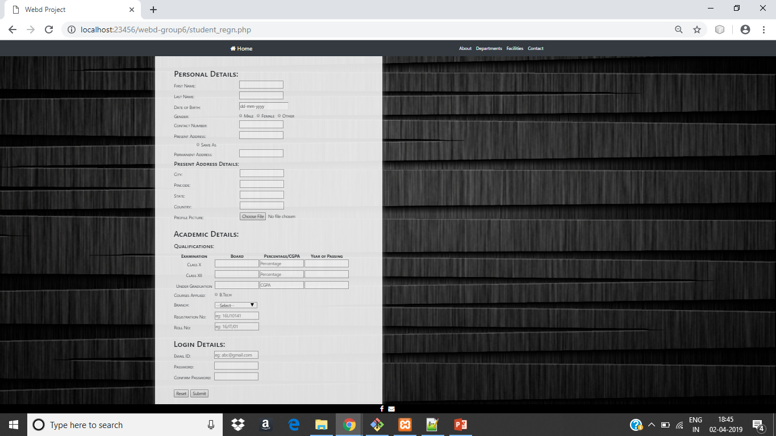
Sign up form :
Date: 30/01/2019
Week: 2

Slide 16
Next Week’s
Tasks
Add more web pages and link it to the current home page.
Make the ER Model.
Design Database Schema
Date: 30/01/2019
Week: 2

Slide 17
Work
Division
16IT8012: Did the styling of the student_login page.
16IT8024: Made the student_login page.
16IT8067: Made the changes and addition of pages in the presentation.
Date: 06/02/2019
Week: 3

Slide 18
Entity - Relationship Model

Slide 19
Contact
Password
Email
Roll No
Password
controls
Email
Admin
Student
Name
Contact
Username
Department
Address
State
Pincode
City
Date: 06/02/2019
Week: 3

Slide 20
ADMIN
Email VARCHAR(30)
Username VARCHAR(30)
Password VARCHAR(30)
Contact VARCHAR(30)
STUDENT
Roll No INT(10)
Email VARCHAR(30)
Username VARCHAR(30)
Password VARCHAR(30)
Contact VARCHAR(30)
State VARCHAR(30)
City VARCHAR(30)
Pincode INT(10)
Date: 06/02/2019
Week: 3

Slide 21
What we Did ?
Made home page for the student after login.
This page consists of a navbar with menu options - Home, About, Departments, Facilities, Profile and Logout..
The body contains the detailed section of the topics in navbar.
Footer of the page contains the link to the institute’s facebook page and email options to contact the Director of the institute.
Date: 06/02/2019
Week: 3

Slide 22
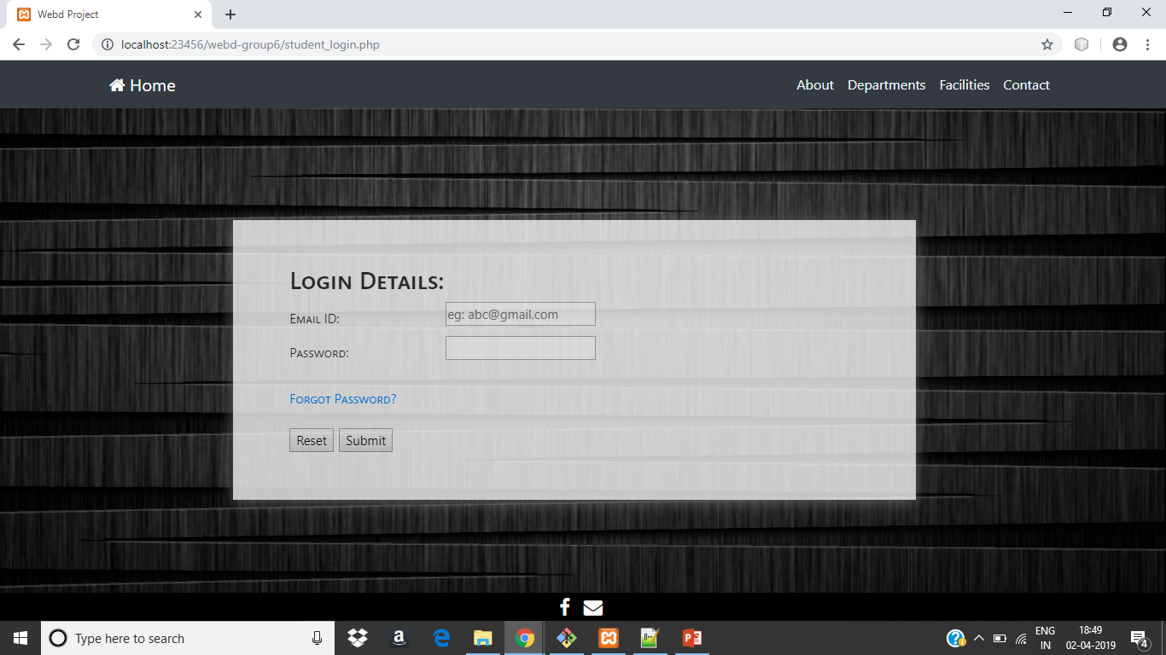
Student Login Form:
Date: 06/02/2019
Week: 3

Slide 23
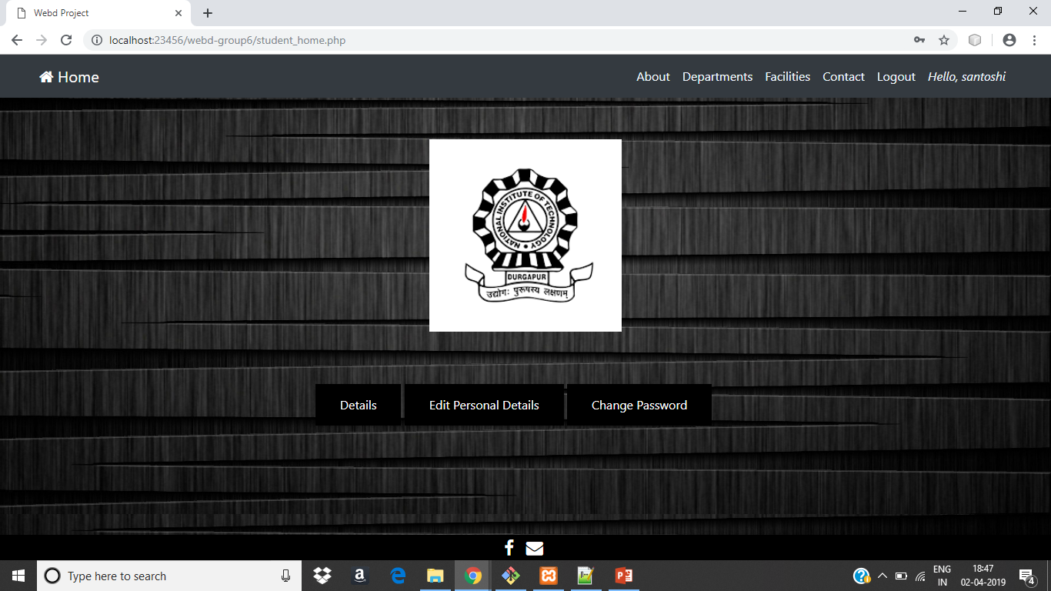
Student Home Page:
Date: 06/02/2019
Week: 3

Slide 24
Next Week’s
Tasks
Add more web pages and link it to the current home page.
Make the database in MySQL.
Working of sign-up form using php.
Date: 06/02/2019
Week: 3

Slide 25
Work
Division
16IT8012: Made validations using Javascript.
16IT8024: Made the database schema using PHP.
16IT8067: Made the profile page of student.
Date: 13/02/2019
Week: 4

Slide 26
What we Did ?
Made validations in the registration form.
Created the database schema in phpmyadmin.
Linked all the web pages .
Made the student’s profile page which have three sections : Personal Details , Academic Details and Login Details.
Date: 13/02/2019
Week: 4

Slide 27
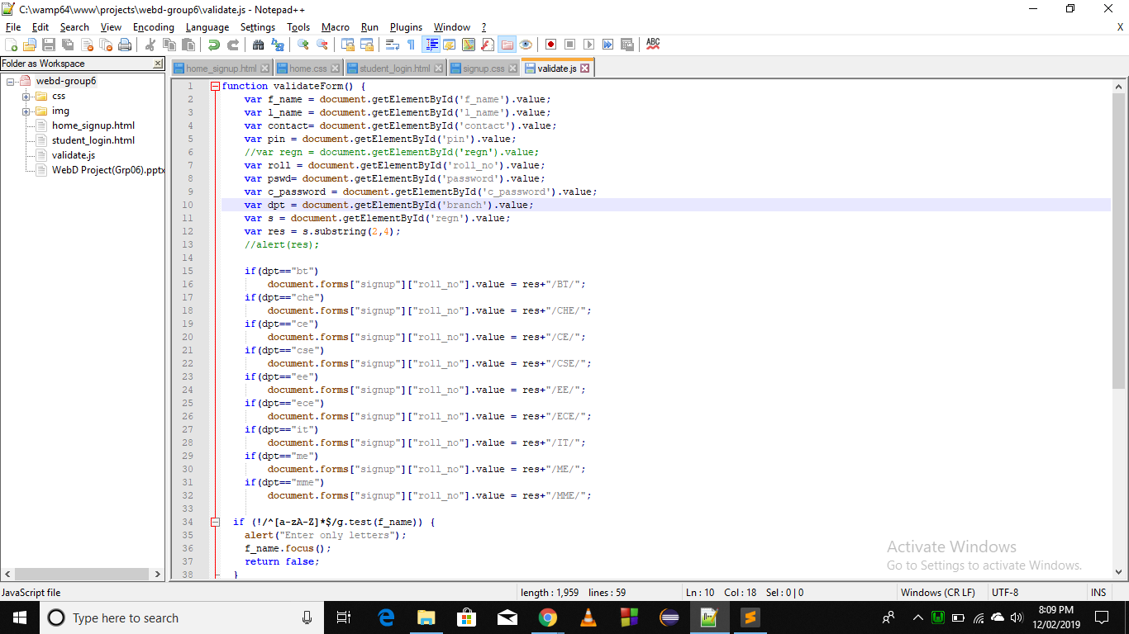
Validations Code:
Date: 13/02/2019
Week: 4

Slide 28
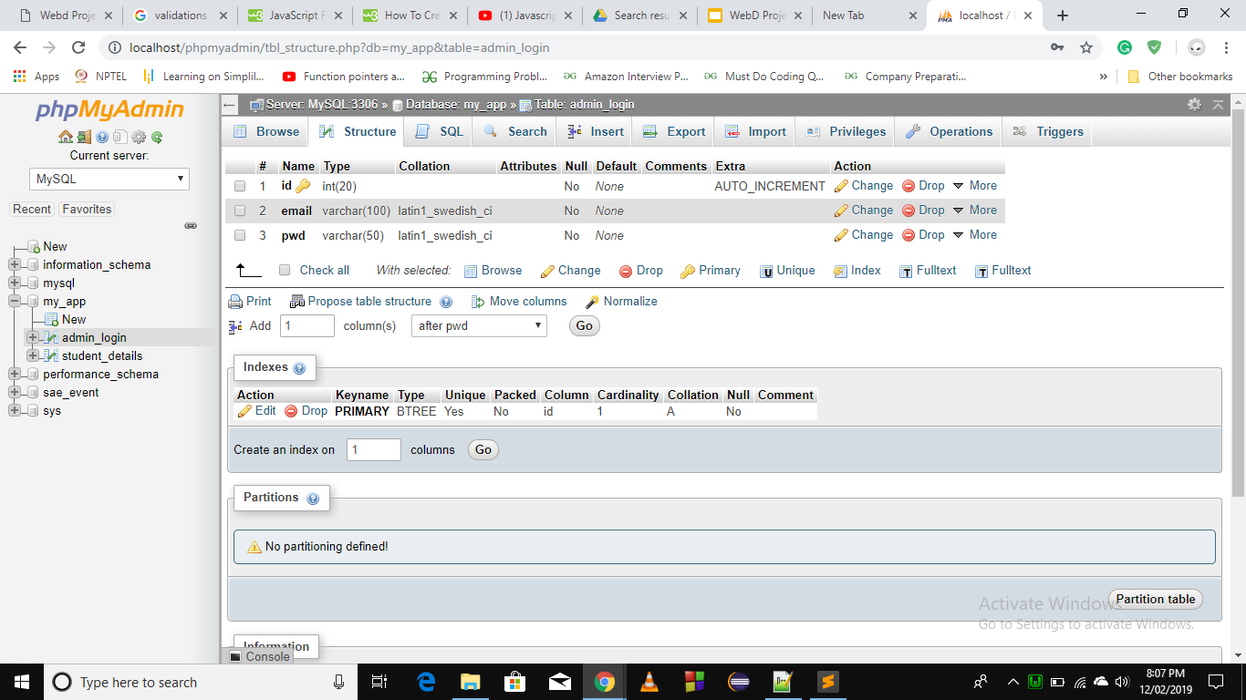
Admin’s Database:
Date: 13/02/2019
Week: 4

Slide 29
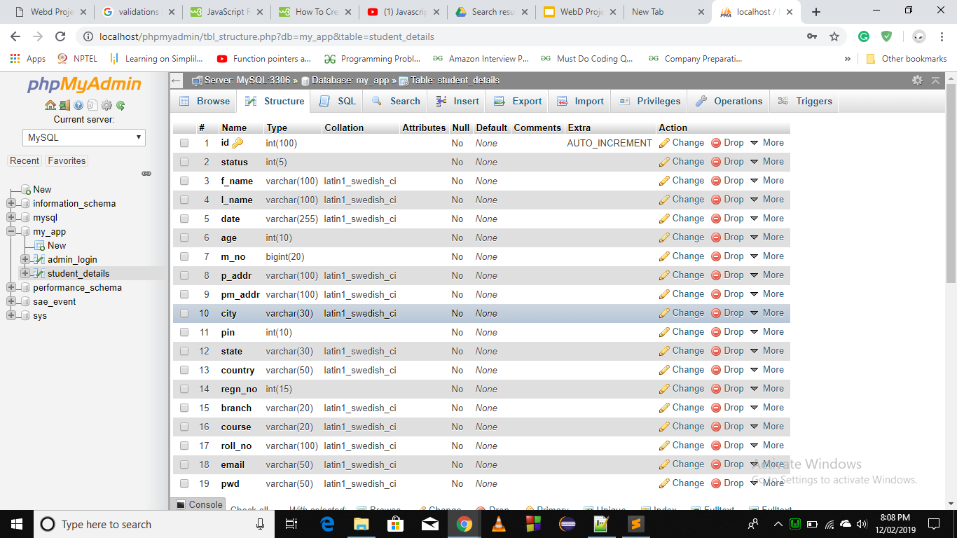
Student’s Database:
Date: 13/02/2019
Week: 4

Slide 30
Next Week’s
Tasks
Add more web pages and link it to the current home page.
Working of sign-up form using php.
Date: 13/02/2019
Week: 4

Slide 31
Work
Division
16IT8012: Made validations using Javascript and admin signup form.
16IT8024: Made validations using Javascript and admin home page .
16IT8067: Made presentation.
Date: 27/02/2019
Week: 5

Slide 32
What we Did ?
Created Admin Login form.
Made validations in the registration form using java script.
First and last name, city, state and country must contain only alphabets.
Phone no. and pin code must contain only digits of size 10 and 6 respectively.
Roll no. will be half-filled according to the branch and year of study.
Password must be of 8 or more characters and must contain at least 1 uppercase, 1 lowercase and 1 digit.
Unmatching of passwords will give an alert message.
Date: 27/02/2019
Week: 5

Slide 33
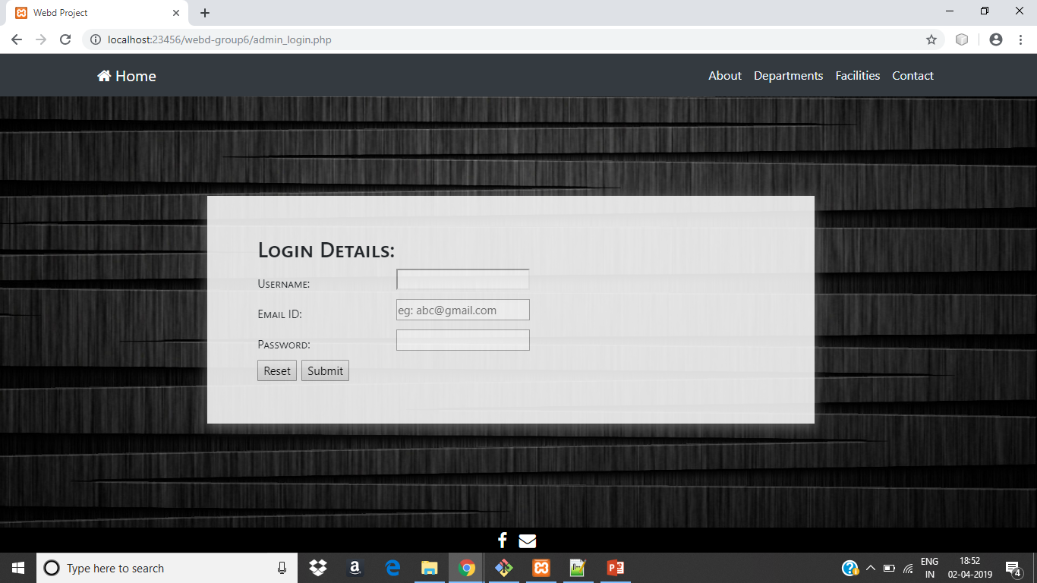
Admin Login form :
Date: 27/02/2019
Week: 5

Slide 34

Admin Home page:
Date: 27/02/2019
Week: 5

Slide 35
Next Week’s
Tasks
Add more web pages and link it to the current home page.
Working of sign-up form using php.
Date: 27/02/2019
Week: 5

Slide 36
Work
Division
16IT8012: Created the admin login page and checks for the valid login details.
16IT8024: Created the student login page and checks for the valid details.
16IT8067: Made presentation.
Date: 06/03/2019
Week: 6

Slide 37
What we Did ?
Checks whether it is a valid admin or not.
Checks whether it is a valid entry or not.
Connected the registration form of the student to the database so that all the entered details of the student is stored in the table ‘student_details’.
Added image field in the student’s registration form.
Date: 06/03/2019
Week: 6

Slide 38
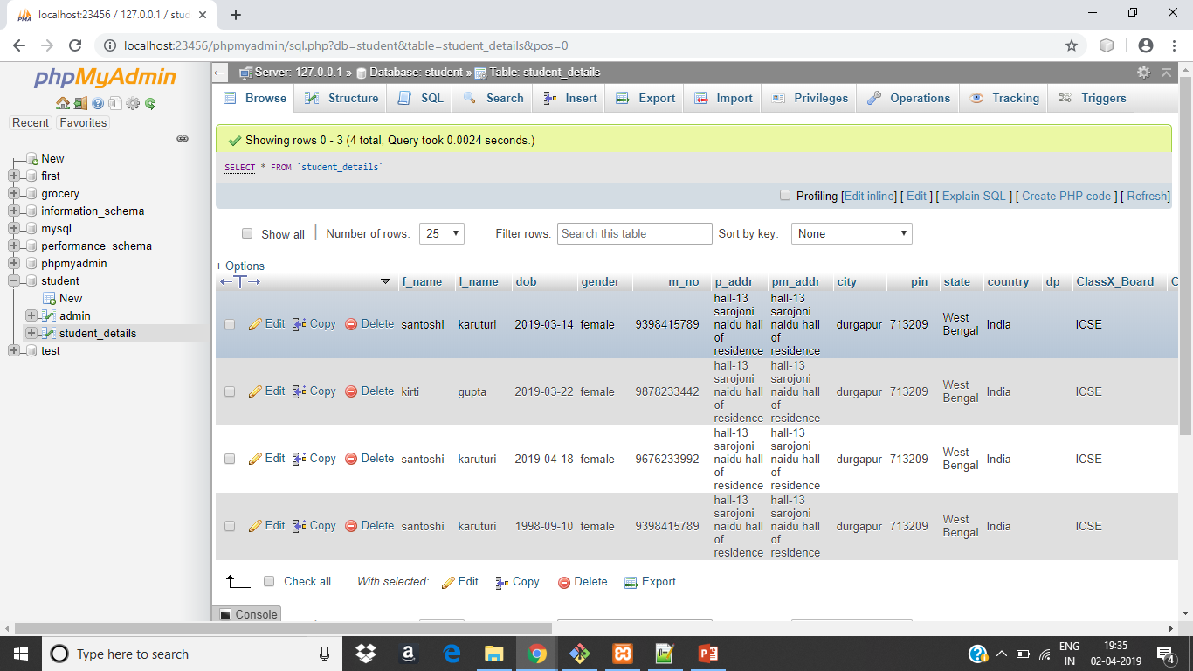
Student details table:
Date: 06/03/2019
Week: 6

Slide 39
Next Week’s
Tasks
Add more web pages and link it to the current home page.
Giving access to the admin for accepting or modifying the student’s database.
Display the proper pages after logging in.
Date: 06/03/2019
Week: 6

Slide 40
Work
Division
16IT8012: Admin is given the authority to accept and reject student’s data.
16IT8024: Modified the database.
16IT8067: Made Validations.
Date: 13/03/2019
Week: 7

Slide 41
What we Did ?
Modified the database by adding extra fields like image.
Made validations to the registration from.
Connected the registration form of the student to the database so that all the entered details of the student is stored in the table ‘student_details’.
Admin will given the authority to accept and reject a student’s data.
Date: 13/03/2019
Week: 7

Slide 42
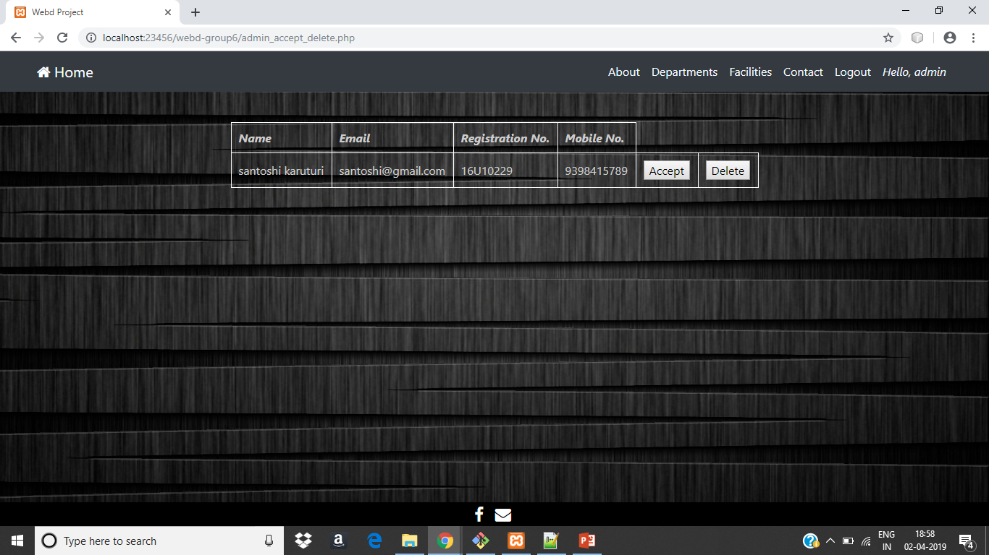
Accept and Delete new entries :
Date: 13/03/2019
Week: 7

Slide 43
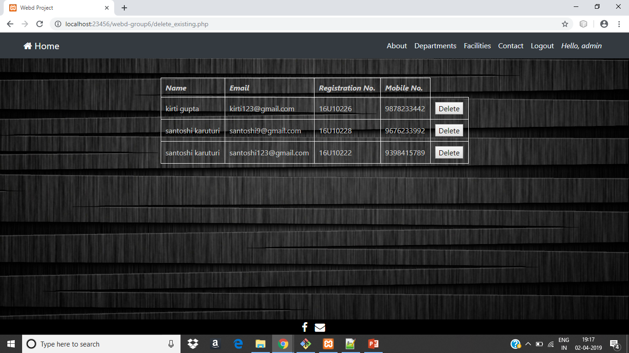
Deleting the entry of the existing student
Date: 13/03/2019
Week: 7

Slide 44
Next Week’s
Tasks
Make student’s profile page.
Giving access to the admin to modifying the student’s database.
Date: 13/03/2019
Week: 7

Slide 45
Work
Division
16IT8012: Made session handling and added some extra features to the admin to modify a students data base.
16IT8024: Created forgot password option and student can edit his own details.
16IT8067: Made presentation.
Date: 28/03/2019
Week: 8

Slide 46
What we Did ?
Created session handling .
Made validations to the registration from.
Created forgot password option for the student
Admin will given the authority to accept and reject a student’s data and modify the database of the student.
Student can edit his own details.
Date: 28/03/2019
Week: 8

Slide 47
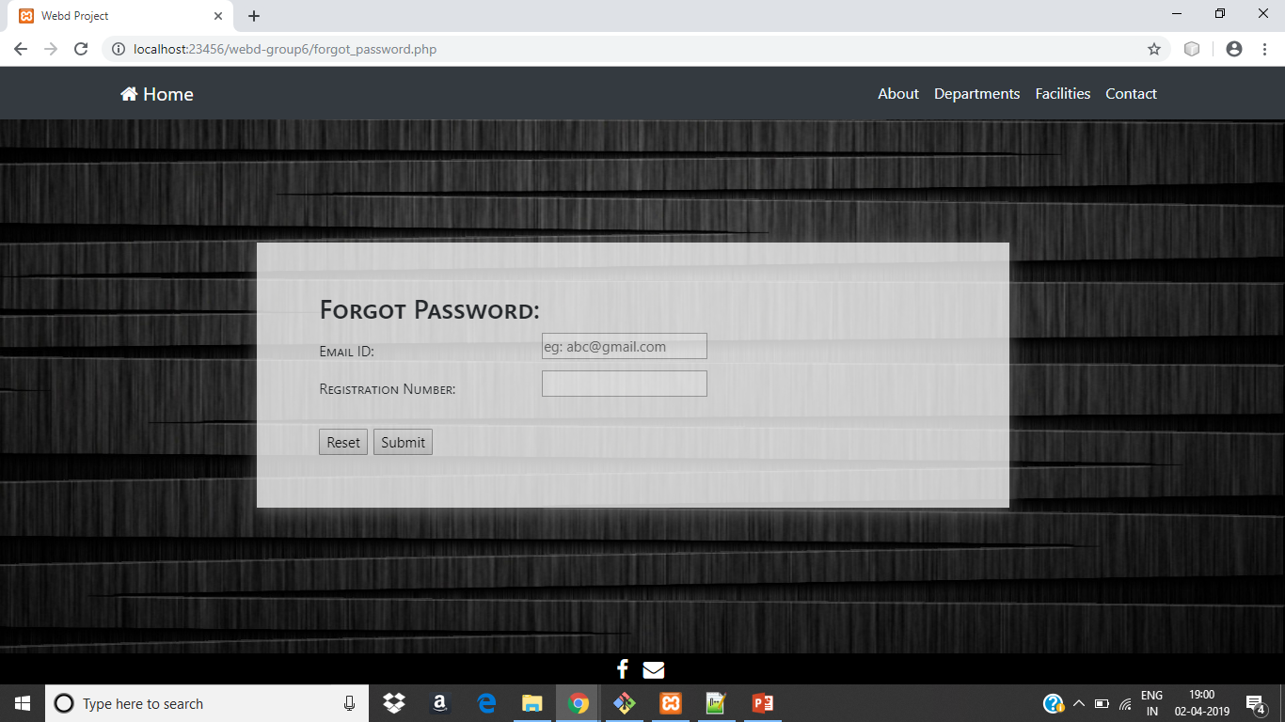
Forgot Password :
Date: 04/04/2019
Week: 9

Slide 48
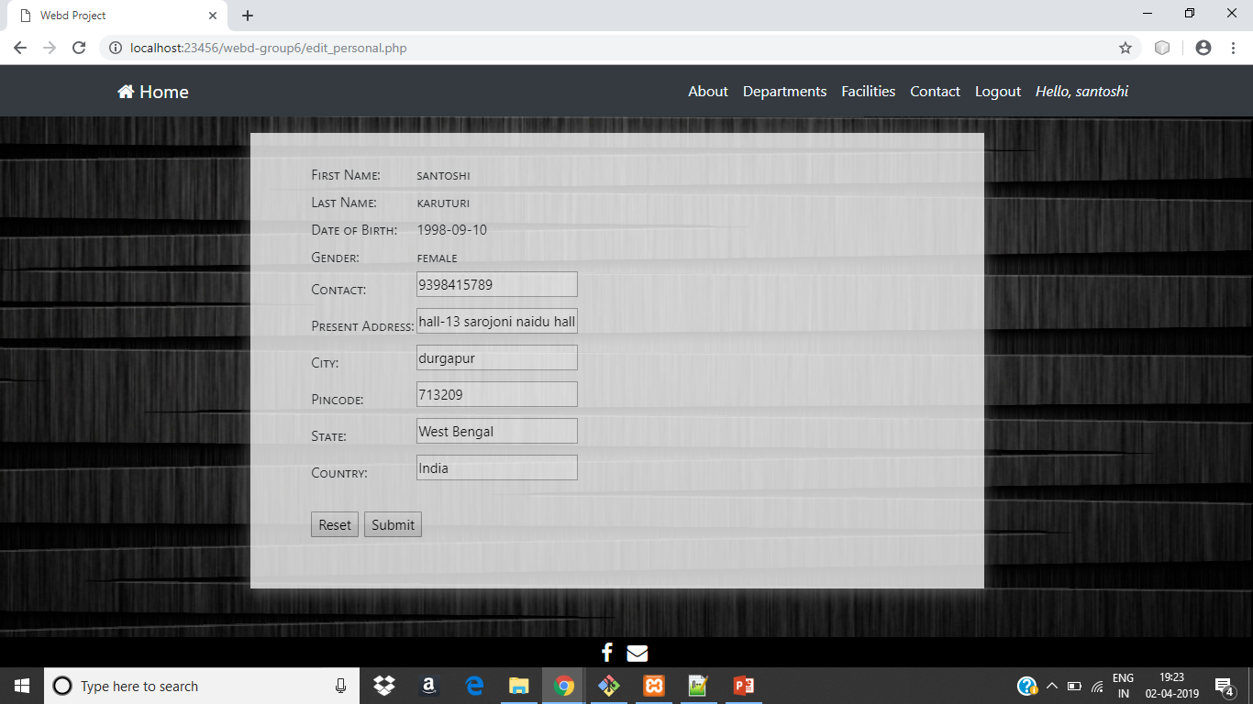
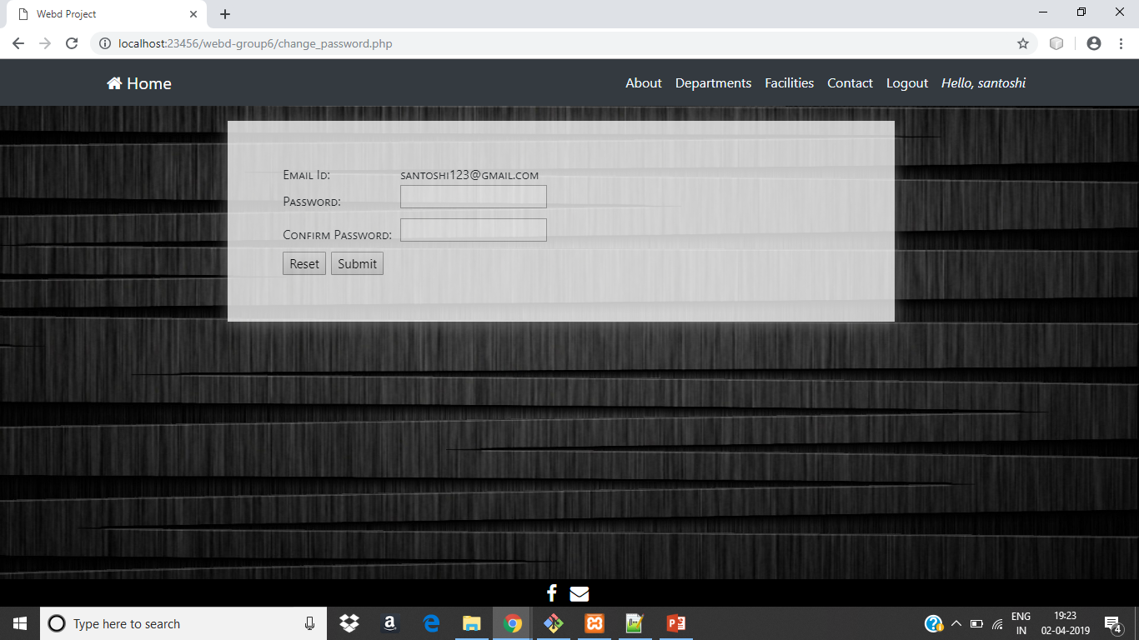
Editing student’s data by himself:
Date: 04/04/2019
Week: 9

Slide 49
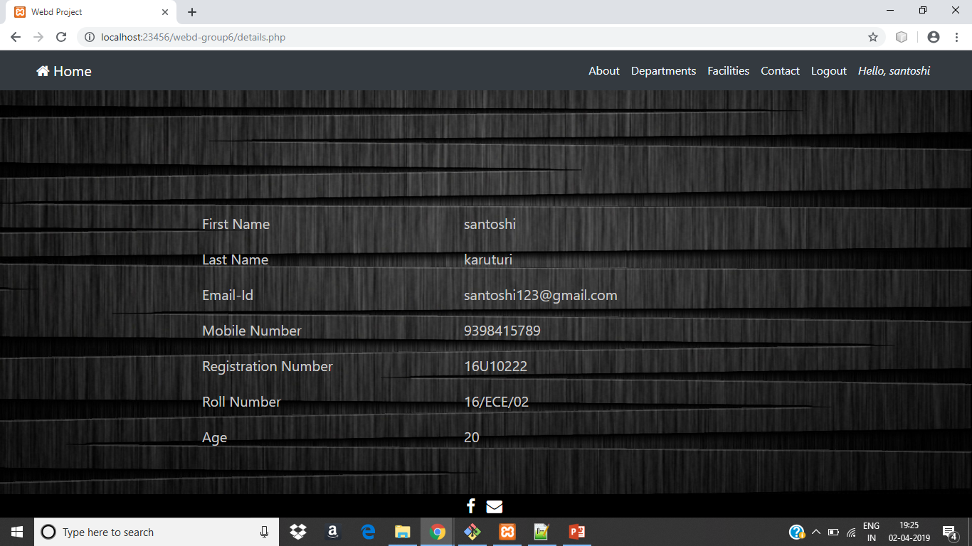
Personal details of the student:
Date: 04/04/2019
Week: 9

Slide 50
Next Week’s
Tasks
Updating the students profile page and adding some features to it.
Updating admin’s features for editing the student’s database.
Date: 28/03/2019
Week: 8

Slide 51
Work
Division
16IT8012: Made student’s profile page ,session handling and extra options for the student like to edit his own data.
16IT8024: Created various options for the admin to modify the student data like accept and delete and modify the entries of the student.
16IT8067: Made presentation.
Date: 04/04/2019
Week: 9

Slide 52
What we Did ?
Created session handling .
Admin can delete the existing entries of the student and can accept or reject the new entries and also can edit the details of the student.
Student can edit his own details (Personal details, Login details ) if he/she wish for.
Calculated the age of the student and displayed it in his profile.
Date: 04/04/2019
Week: 9

Slide 53

Update students data:
Date: 04/04/2019
Week: 9

Slide 54
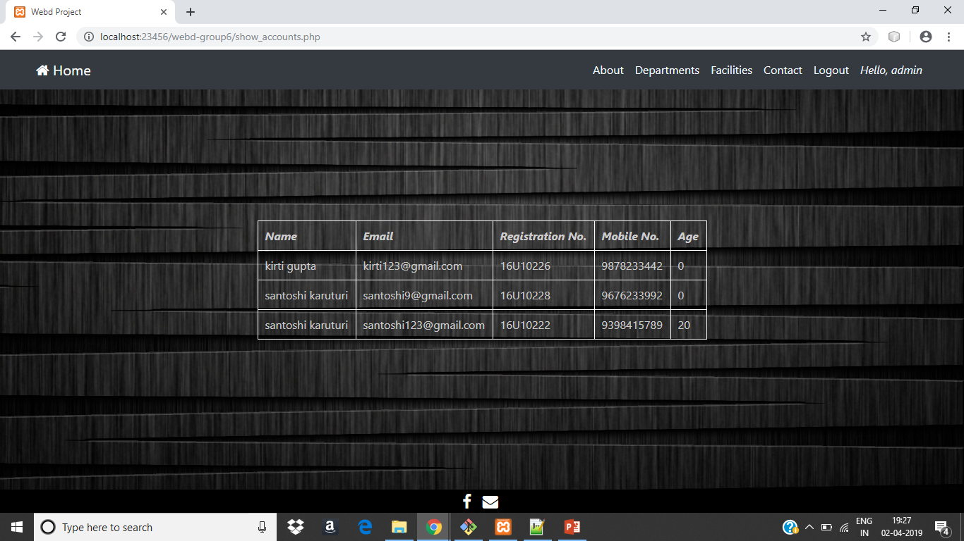
Display the details of all students :
Date: 04/04/2019
Week: 9

